Slide 1

Real Estate Property Webapp
Py98 | Prabhakar Omprakash Yadav

Slide 2
Functionality
Admin and Realtors will add property through backend Django Admin page
Customers will register and then enquire for property
Customers will submit a form for enquire about particular property
Anyone can view property and property details

Slide 3
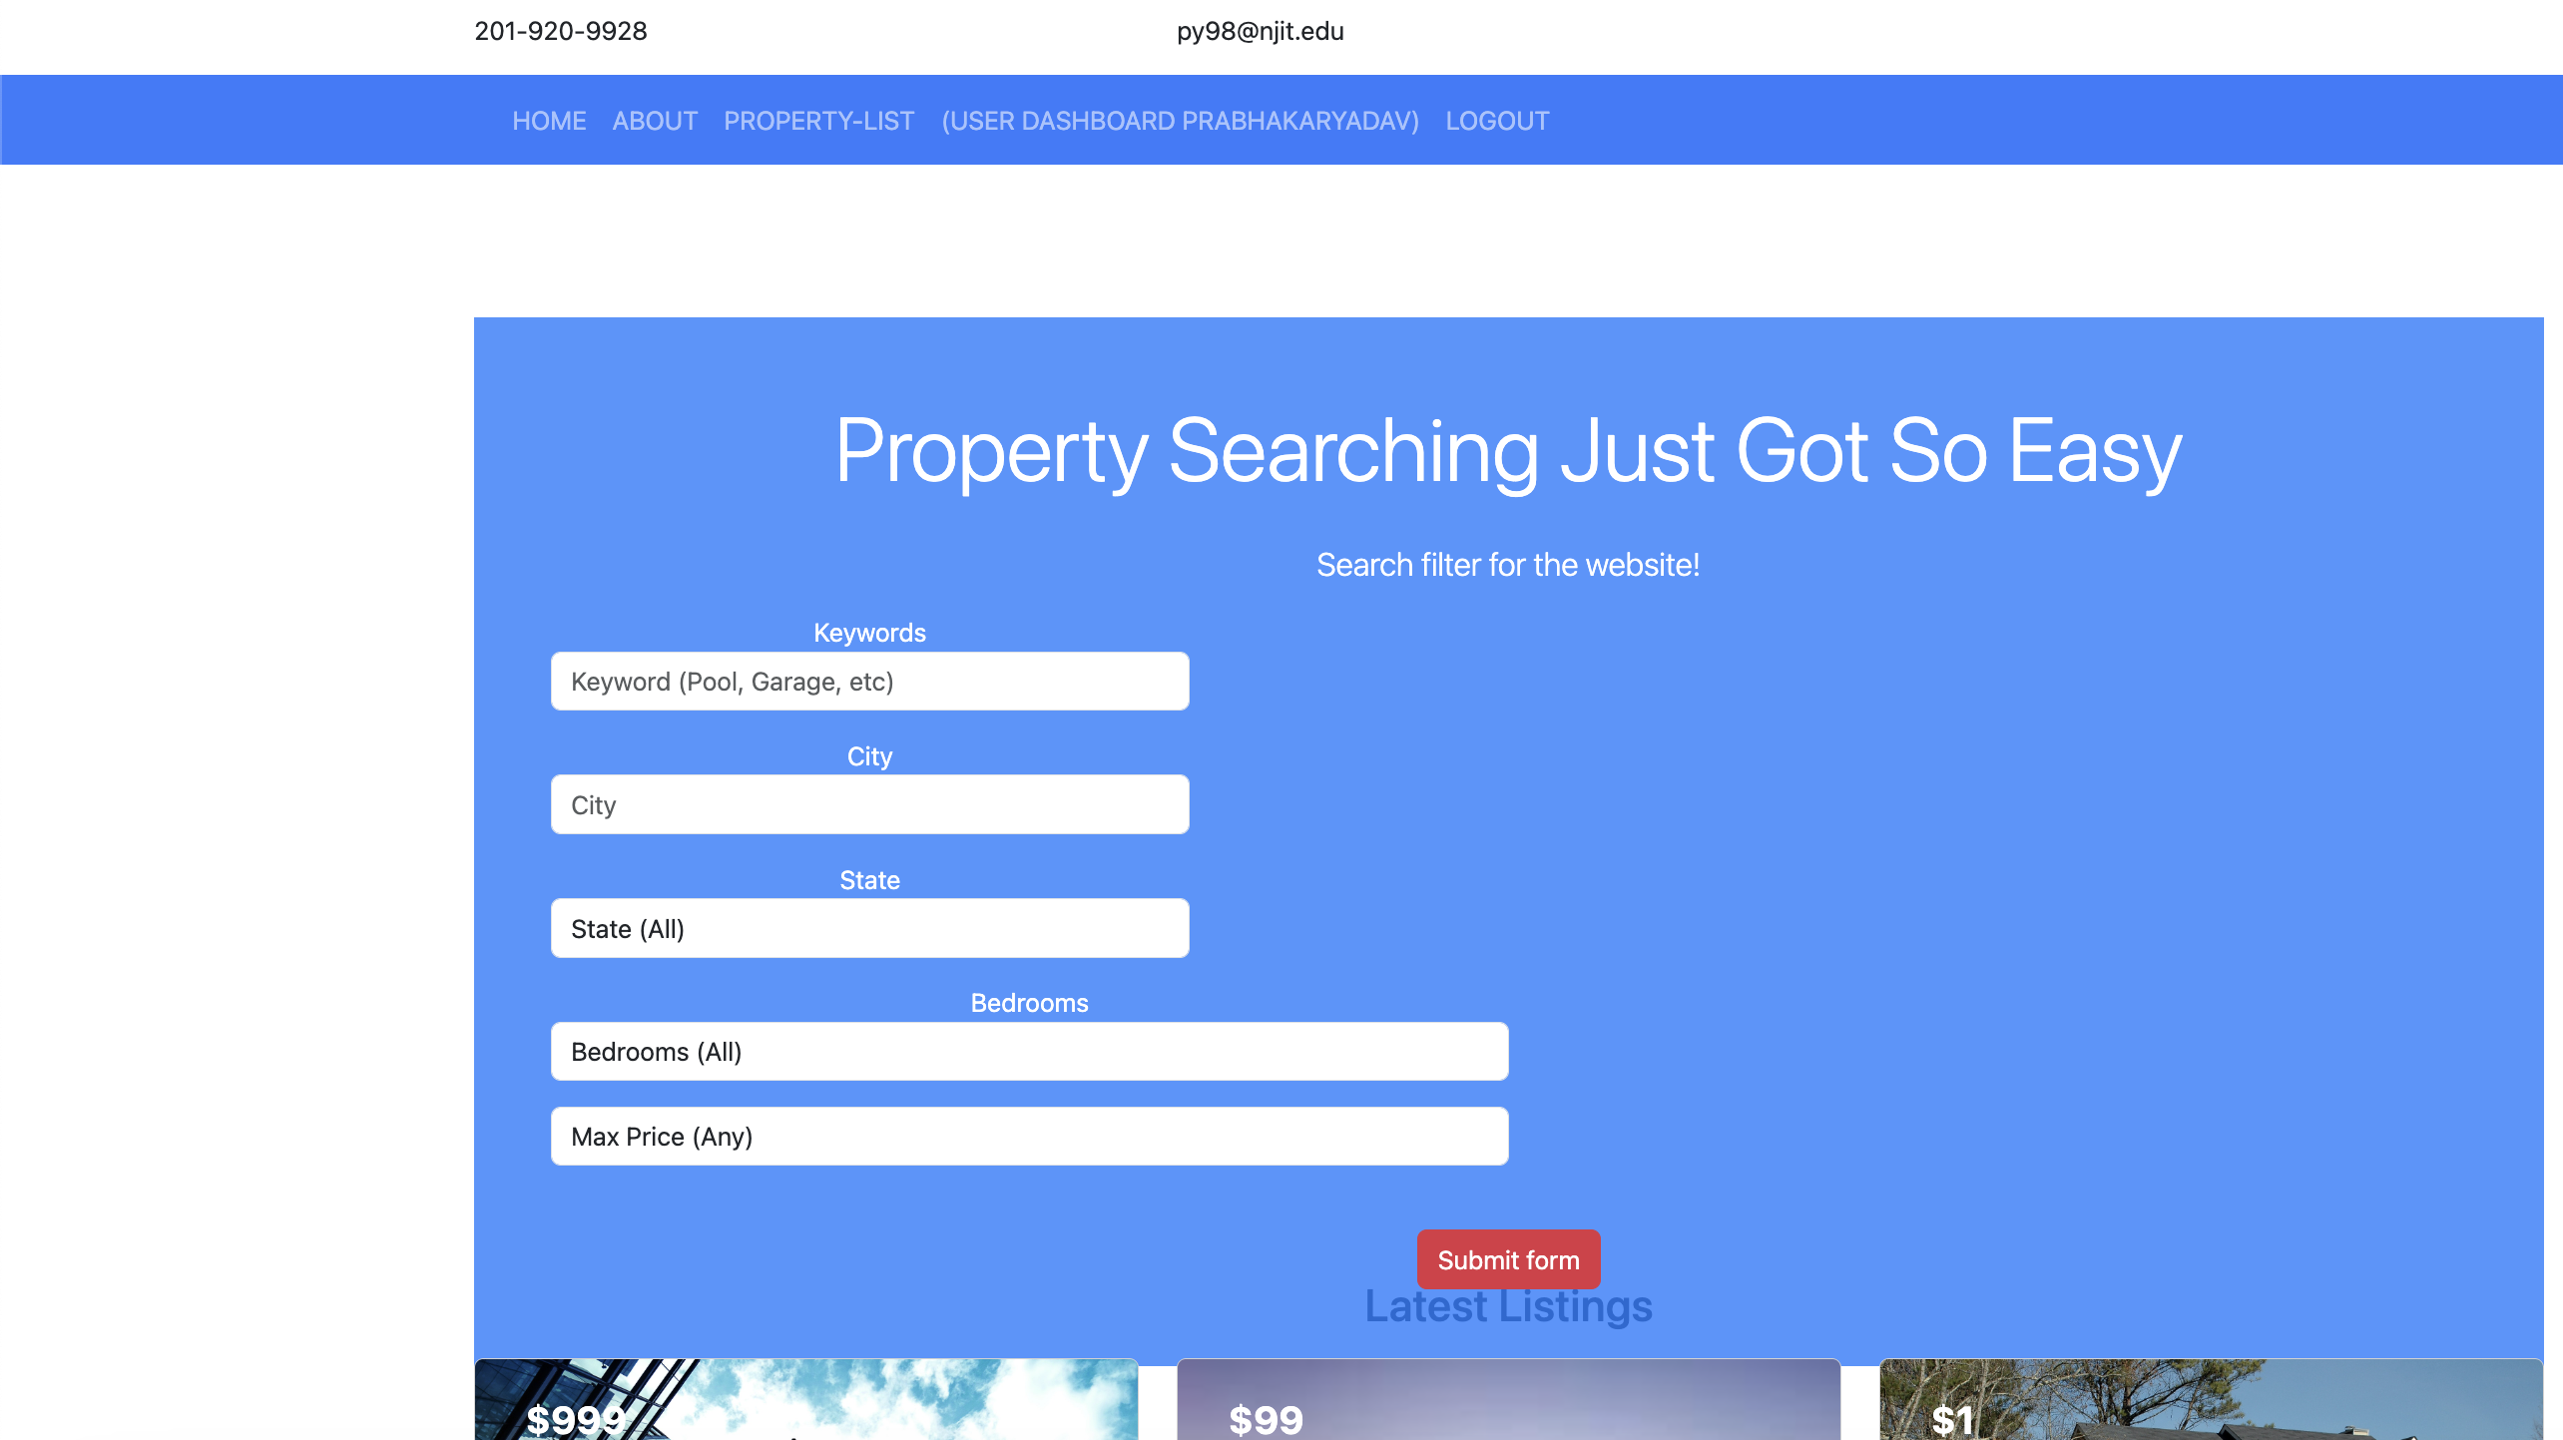
Search Functionality For property search

Slide 4
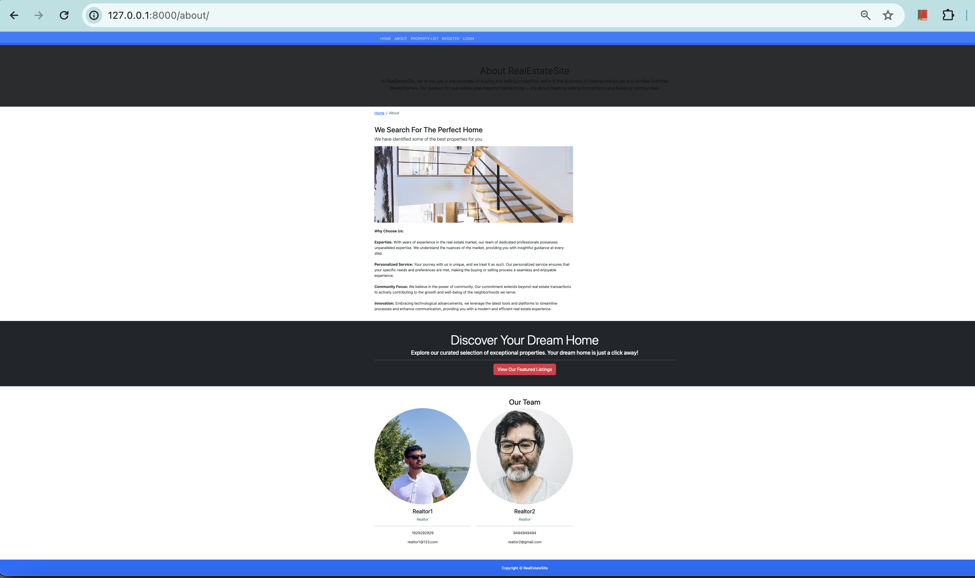
About Page showing detail of website and realtors detail from Realtor model

Slide 5
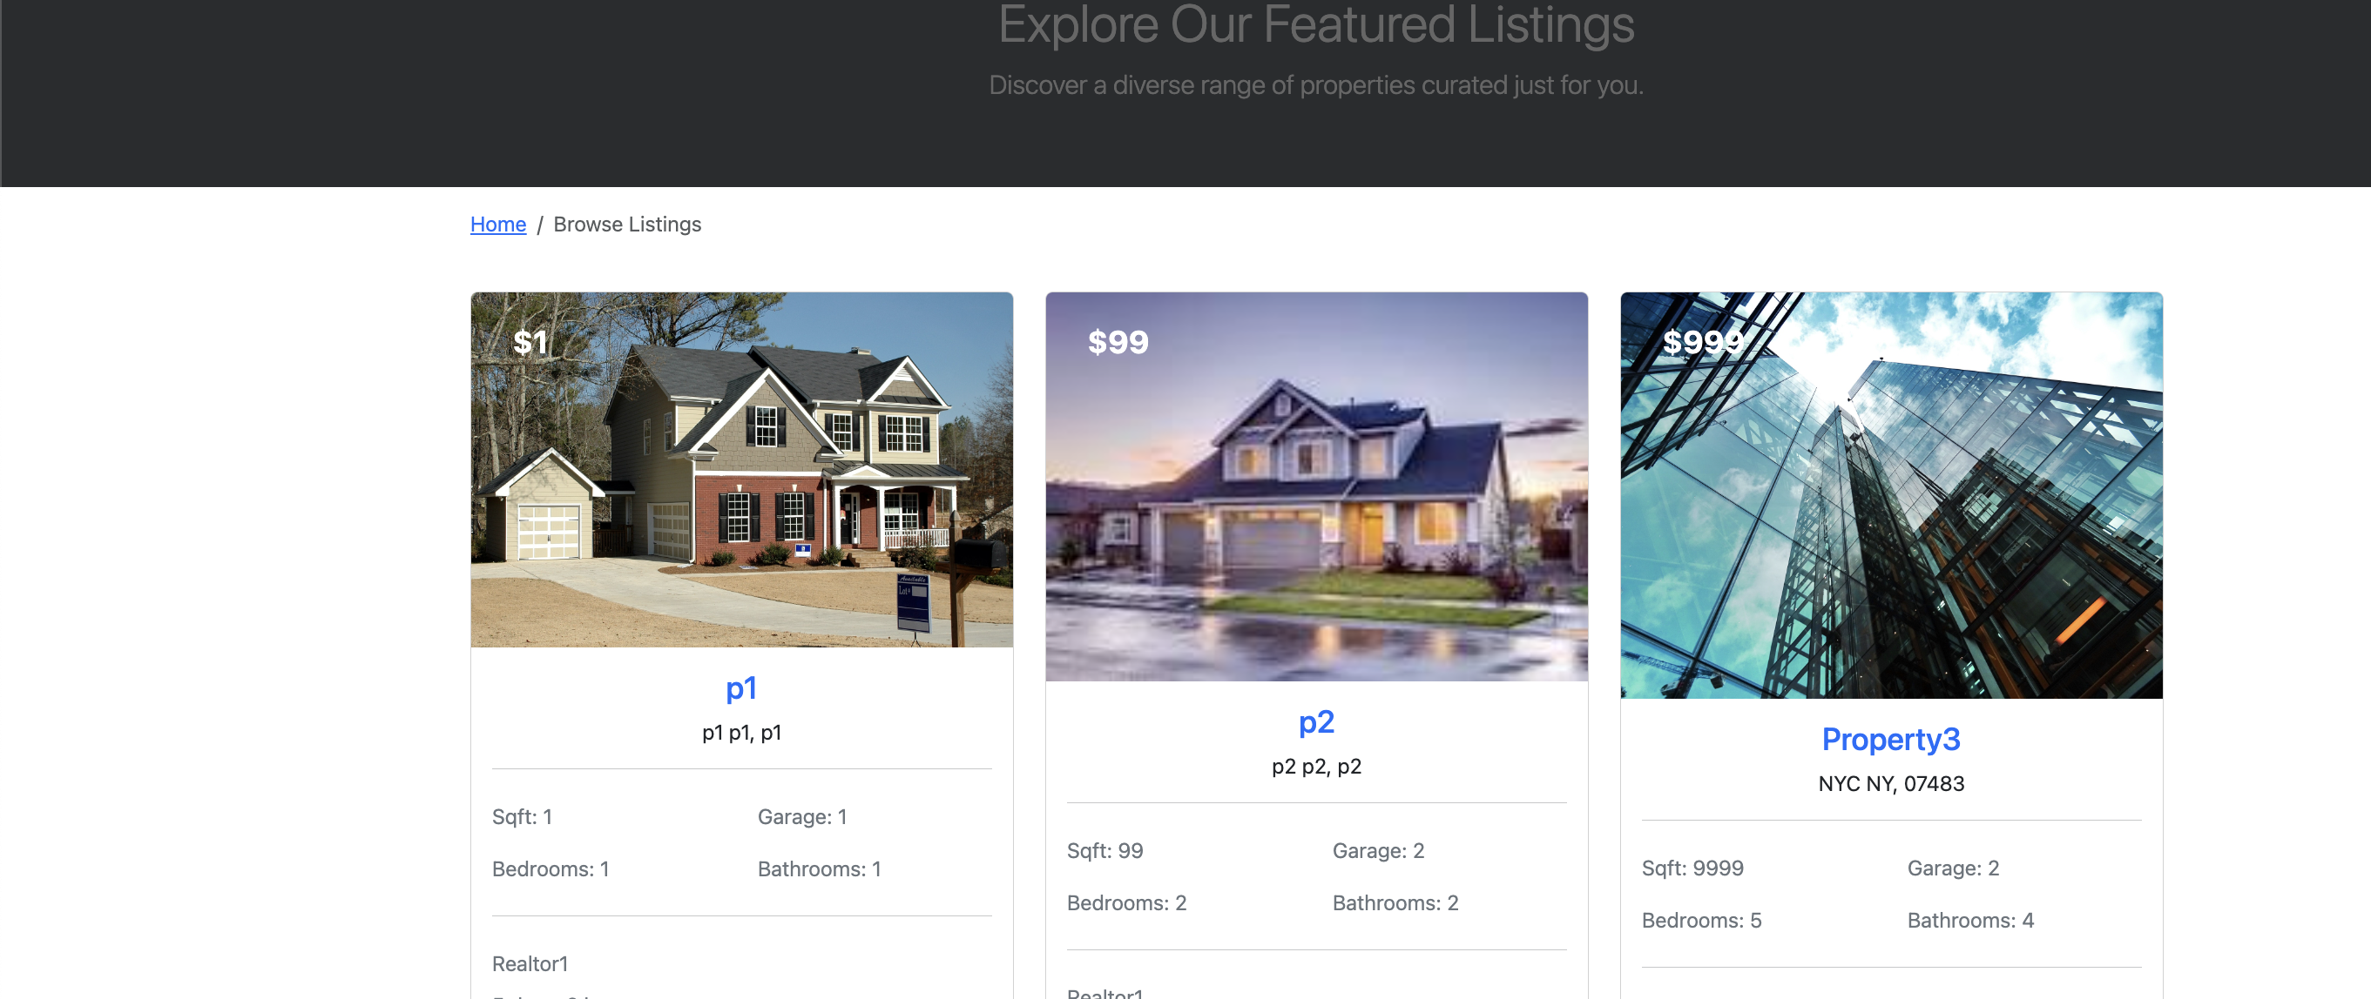
Property Listing Page showing list of properties

Slide 6
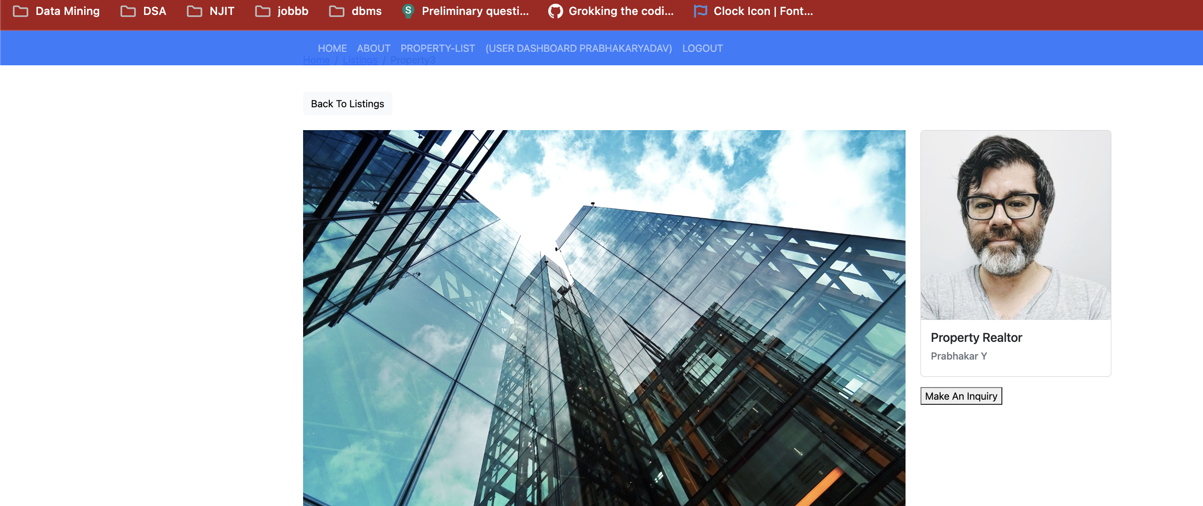
Property details

Slide 7
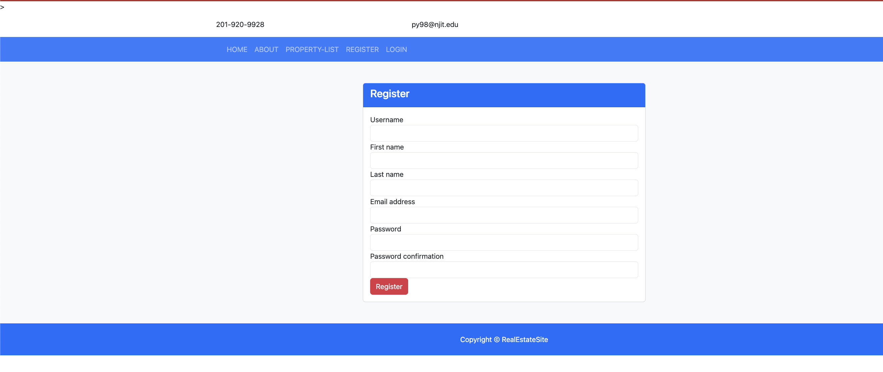
User Registration

Slide 8
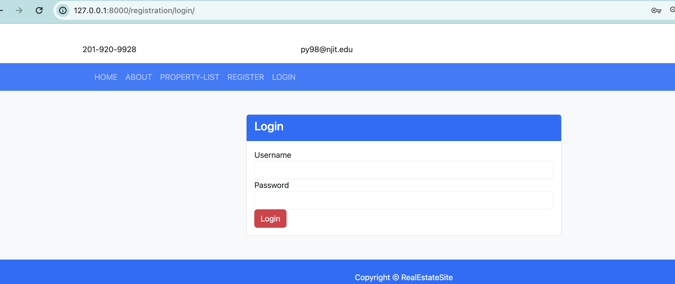
Login page

Slide 9
Django administration
Only User with staff status can access admin panel for adding Realtors and adding their properties.
Enhancement work
Users logged in and logged out can make inquiry for property to realtor. (Future work)
Creating Add Property navigation for staff users

